Slide 1
Chapter 1 Fundamentals of the Analysis of Algorithm Efficiency

Slide 2
Body of Knowledge Coverage:
Basis Analysis (AL)
Basis Analysis (AL)
Asymptotic Analysis, empirical measurement.
Differences among best, average, and worst case behaviors of an algorithm.
Complexity classes, such as constant, logarithmic linear, quadratic, and exponential.
Recurrence Relations and their solutions.
Time and space trade-offs in algorithms.

Slide 3
Algorithm Analysis Framework with Examples

Slide 4
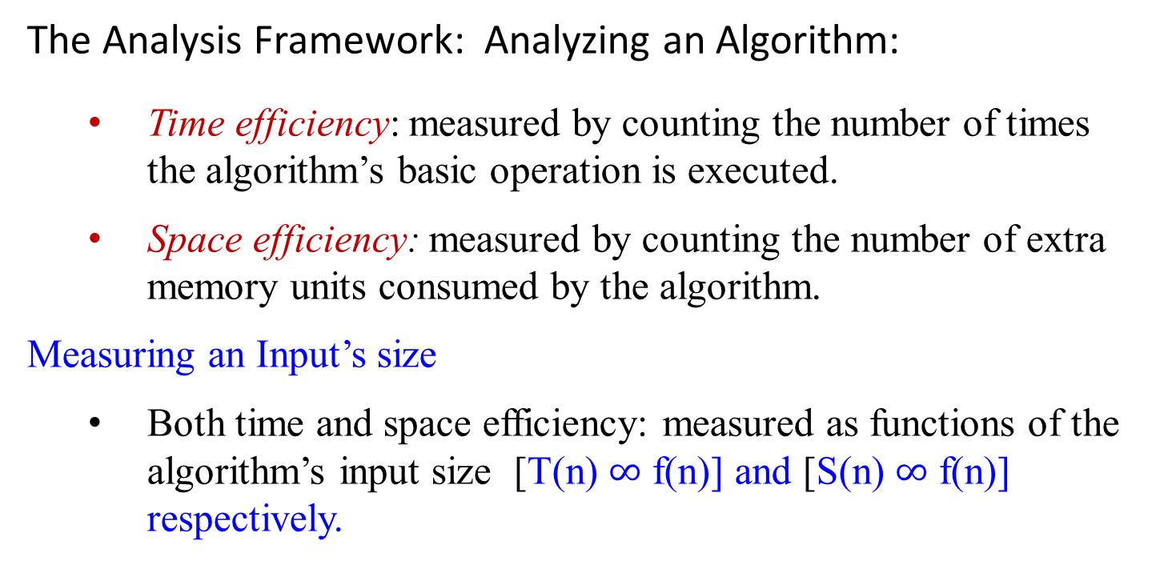
The Analysis Framework: Analyzing an Algorithm:
Time efficiency: measured by counting the number of times the algorithm’s basic operation is executed.
Space efficiency: measured by counting the number of extra memory units consumed by the algorithm.
Measuring an Input’s size
Both time and space efficiency: measured as functions of the algorithm’s input size [T(n) $∞$ f(n)] and [S(n) $∞$ f(n)] respectively.

Slide 5
Measuring an Input’s size
Define the running time of a program as a function of the size of its input, T(n) ∞ f(n).
the time taken by an algorithm grows with the size of the input.
The input size is measured the number of items in the input.
For sorting algorithm, the input size is the number of items n in the array. T(n) ∞ f(n).
An algorithm for computing nth Fibonacci item, n is the input but not the size of the input. T(n) ∞ f(n), where n = └ log₂ n ┘ + 1.
A reasonable measure of the size of the input is the number of symbols used to encode n, which is └ log₂ n ┘ + 1.
Multiplying two integers n, m is the total number of bits for n, m. (i.e, bits(n) * bits(m)); i.e., ((└ log₂ n ┘ + 1) * (└ log₂ m ┘ + 1)).

Slide 6
The Analysis Framework: Analyzing an Algorithm:
Units for measuring running time
Identify the basic operation of the algorithm,
Compute the number of times the basic operation is executed.
Estimate the running time T(n) of a program
T(n) ≈ c_{op} * C(n), where
C(n) be the number of times this operation needs to be executed for this algorithm.
c_{op} be the execution time (such as nanosec/instruction) of an algorithm’s basic operation on a particular computer.

Slide 7
In general,
the running time of algorithm
increases with the size of input, and
is roughly proportional to the number of times some basic operation (such as a comparison instruction) is executed.
Therefore, analyze the algorithm’s efficiency by
determining the number of times some basic operation is executed as a function of the size of input.
T(n) ∞ f(n).

Slide 8

To determine how efficiently an algorithm solves a problem, we analyze the efficiency of an algorithm in terms of time.
Do not determine the actual number of CPU cycles
because this depends on the particular computer on which the algorithm is run.
Do not count every instruction executed,
because the number of instructions depends on the programming languages used to implement the algorithm and the way the programmer writes the program.
Use a measure which is independent of
computer,
programming language, the programmer, and
all the complex details of the algorithm such as incrementing of loop indices, setting pointers, and so forth.

Slide 9
Order of growth
The framework’s primary interest lies in
the order of growth of the algorithm’s running time as its input size goes to infinity.
log₂ n < n < n log₂ n < n² < n³ < 2^{n} < n!
Algorithms that require an exponential number (i.e., 2^{n} ) of operations are practical for solving only problems of very small sizes.

Slide 10
Order of growth
Figure 1.0 Growth rates of common complexity functions.

Slide 11
Recapitulation of the Analysis Framework
Summarize the main points of the framework:
Both time and space efficiencies are measured as functions of the algorithm’s input size. (i.e, T(n) ∞ f(n)).
Time efficiency is measure by counting the number of times the algorithm’s basic operation is executed. (i.e., T(n) ≈ c_{op} * C(n)).
Space efficiency is measure by counting the number of extra memory units consumed by the algorithm.
The efficiencies of some algorithms may different significantly for inputs of the same size, but also on the input’s property.
For such algorithms, we need to distinguish between the worst-case, average-case, and best-case efficiencies.
The analysis framework’s primary interest lies in the order of growth of
the algorithm’s running time as its input size goes to infinity.

Slide 12
Examples of Algorithms
A 1.1 Sequential Search
Problem: Is the key K in the array A of n keys?
Inputs (parameters): positive integer n, array of keys A indexed from 0
to n-1 and a key K.
Outputs: The index of the first element of A that matches K
or -1 if there are no matching elements.

Slide 13

Algorithm SequentialSearch(A[0 .. n-1], K)
// Searches for a given value in a given array by sequential search
Input: An array A[0 .. n-1] and a search key K
Output: The index of the first element of A that matches K
or -1 if there are no matching elements
i := 0;
while (i < n and A[i] ≠ K) do {
i := i + 1;
}
if (i < n) return i;
else return -1;
Q: which is the basic operation? Why?
Which one costs most?
Is there any different in terms of execution time, if we design as ?
i := 0;
while (i < n)
{if (A[i] ≠ K) {i := i +1;}}
if (i < n) return i;
else return -1;

Slide 14
Algorithm SequentialSearch(A[0 .. n-1], K)
// Searches for a given value in a given array by sequential search
Input: An array A[0 .. n-1] and a search key K
Output: The index of the first element of A that matches K
or -1 if there are no matching elements
i := 0;
A[n] = K;
while (A[i] ≠ K) do {
i := i + 1;
}
if (i < n) return i;
else return -1;

Slide 15

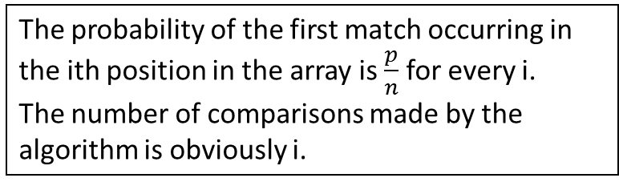
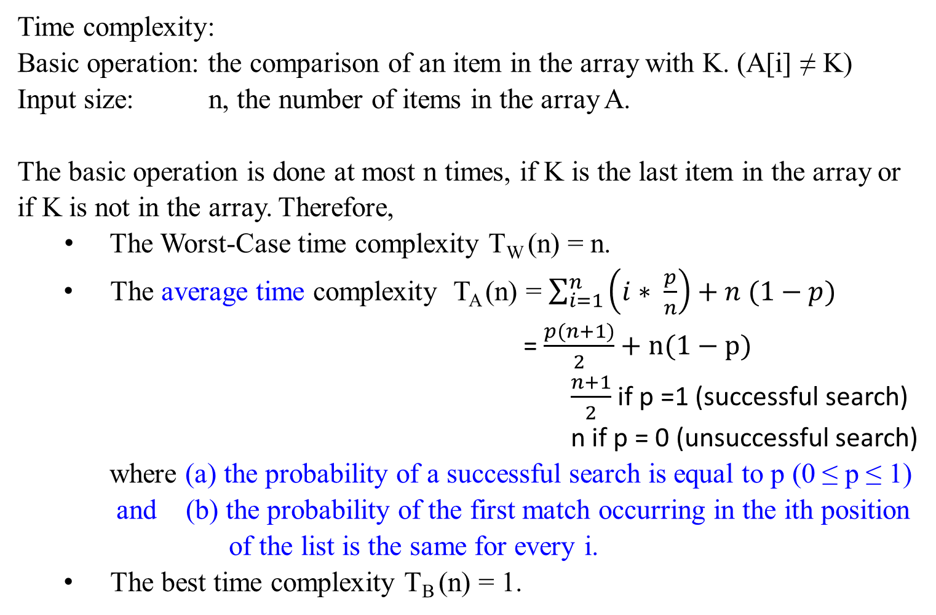
Time complexity:
Basic operation: the comparison of an item in the array with K. (A[i] ≠ K)
Input size: n, the number of items in the array A.
The basic operation is done at most n times, if K is the last item in the array or if K is not in the array. Therefore,
The Worst-Case time complexity T_{W} (n) = n.
The average time complexity T_{A} (n) = $\sum_{i=1}^{n}{\left(i∗ \frac{p}{n}\right)+n (1−p)}$
= $\frac{p(n+1)}{2}+n(1−p)$
$\frac{n+1}{2}$ if p =1 (successful search)
n if p = 0 (unsuccessful search)
where (a) the probability of a successful search is equal to p (0 ≤ p ≤ 1) and (b) the probability of the first match occurring in the ith position
of the list is the same for every i.
The best time complexity T_{B} (n) = 1.
The probability of the first match occurring in the ith position in the array is $\frac{p}{n}$for every i.
The number of comparisons made by the algorithm is obviously i.
=

Slide 16
A 1.2 Add Array Members
Problem: Add all the numbers in the array A of n numbers.
Inputs: positive integer n, array of numbers A indexed from 0 to n-1.
Outputs: result, the sum of the numbers in A.
Number sum (int n, const number A[ ])
{
index i;
number result;
result = 0;
for (i = 0; i < n; i++)
result = result + A[i];
return result;
}
Q: Which one is basic operation? Why?
Which one costs most?
Is there any different in terms of execution time? if we design as i = 0;
while (i < n)
{ result = result + A[i];
i++;}

Slide 17
A 1.2 Add Array Members
Problem: Add all the numbers in the array A of n numbers.
Inputs: positive integer n, array of numbers A indexed from 0 to n-1.
Outputs: result, the sum of the numbers in A.
…
Time complexity:
Basic operation: the additional of an item in the array to result.
Input size: n, the number of items in the array.
Regardless of the values of the numbers in the array, there are n passes through the for loop. Therefore, the basic operation is always done n times and
T(n) = n.

Slide 18
A 1.3 Exchange Sort
Problem: Sort n keys in nondecreasing order.
Inputs: positive integer n, array of keys A indexed from 0 to n -1.
Outputs: the array A containing the keys in nondecreasing order.
void exchangeSort (int n, array A[ ])
{
index i, j;
for ( i = 1; i < n; i++)
{ for (j = i + 1; j < n; j++)
{ if (A[j] < A[i])
exchange A[i] and A[j];
}
}
}
Q: which one is the basic operation? why?
For each i (0 < i < n) , you need n-i (A[j] < A[i])-comparisons.
Will these comparisons guarantee that the A[1] A[2] … A[i] are in order?
How do you arrange this in decreasing order?
Is time efficiency T[n] in n².
5 4 3 2 1
4 5 3 2 1
3 5 4 2 1
2 5 4 3 1
1 5 4 3 2
1 5 4 3 2
1 4 5 3 2
1 3 5 4 2
1 2 5 4 3

Slide 19


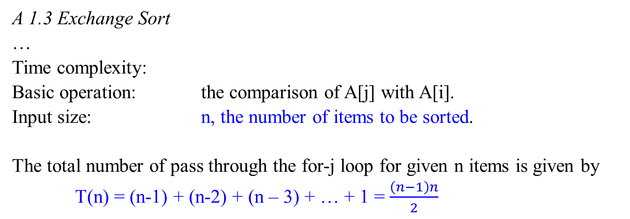
Q: Can we conclude that time efficiency for a nested-for would be a quadratic function.
A 1.3 Exchange Sort
…
Time complexity:
Basic operation: the comparison of A[j] with A[i].
Input size: n, the number of items to be sorted.
The total number of pass through the for-j loop for given n items is given by
T(n) = (n-1) + (n-2) + (n – 3) + … + 1 = $\frac{\left(n−1\right)n}{2}$
$$\sum_{i=1}^{n}{\sum_{j=i+1}^{n}{1= ?}}$$

Slide 20
A 1.4 Matrix Multiplication
Problem: Determine the product of two n x n matrices.
Inputs: a positive integer n, two-dimensional arrays of number A and B, each of which has both its row and columns indexed from 0 to n-1.
Outputs: a two-dimensional array of numbers C, which has both its rows and columns indexed from 1 to n, containing the product of A and
B.
…

Slide 21
A 1.4 Matrix Multiplication
a₀₀ a₀₁ a₀₂ b₀₀ b₀₁ b₀₂
a₁₀ a₁₁ a₁₂ b₁₀ b₁₁ b₁₂ =
a₂₀ a₂₁ a₂₂ b₂₀ b₂₁ b₂₂
a₀₀*b₀₀ + a₀₁ *b₁₀ +a₀₂*b₂₀ a₀₀*b₀₁+a₀₁*b₁₁+a₀₂*b₂₁ a₀₀*b₀₂+a_{01*}b₁₂+a₀₂*b₂₂
a₁₀*b₀₀ + a₁₁ *b₁₀ +a₁₂*b₂₀ a₁₀*b₀₁+a₁₁*b₁₁+a₁₂*b₂₁ a₁₀*b₀₂+a_{11*}b₁₂+a₁₂*b₂₂
a₂₀*b₀₀ + a₂₁ *b₁₀ +a₂₂*b₂₀ a₂₀*b₀₁+a₂₁*b₁₁+a₂₂*b₂₁ a₂₀*b₀₂+a_{21*}b₁₂+a₂₂*b₂₂
i
i k j
j

Slide 22
A 1.4 Matrix Multiplication
a₀₀ a₀₁ a₀₂ b₀₀ b₀₁ b₀₂
a₁₀ a₁₁ a₁₂ b₁₀ b₁₁ b₁₂ =
a₂₀ a₂₁ a₂₂ b₂₀ b₂₁ b₂₂
a₀₀*b₀₀ + a₀₁ *b₁₀ +a₀₂*b₂₀ a₀₀*b₀₁+a₀₁*b₁₁+a₀₂*b₂₁ a₀₀*b₀₂+a_{01*}b₁₂+a₀₂*b₂₂
a₁₀*b₀₀ + a₁₁ *b₁₀ +a₁₂*b₂₀ a₁₀*b₀₁+a₁₁*b₁₁+a₁₂*b₂₁ a₁₀*b₀₂+a_{11*}b₁₂+a₁₂*b₂₂
a₂₀*b₀₀ + a₂₁ *b₁₀ +a₂₂*b₂₀ a₂₀*b₀₁+a₂₁*b₁₁+a₂₂*b₂₁ a₂₀*b₀₂+a_{21*}b₁₂+a₂₂*b₂₂

Slide 23
A 1.4 Matrix Multiplication
Problem: Determine the product of two n x n matrices.
Algorithm MatrixMultiplication(A[0..n-1, 0..n-1], B[0..n-1, 0..n-1])
//Multiple two n-by-n matrices A_{row x col} and B_{row x col} by the definition-based //algorithm
Input: Two n-by-n matrices A and B
Output: Matrix C = A*B
for i ← 0 to n – 1 do //i stands for row
for j ← 0 to n - 1 do //j stands for column.
C[i, j] ← 0.0;
for k ← 0 to n – 1 do
C[i, j] ← C[i, j] + A[i, k]*B[k, j]; //ith row * jth column
return C;
Q: Which one is basic operation?

Slide 24
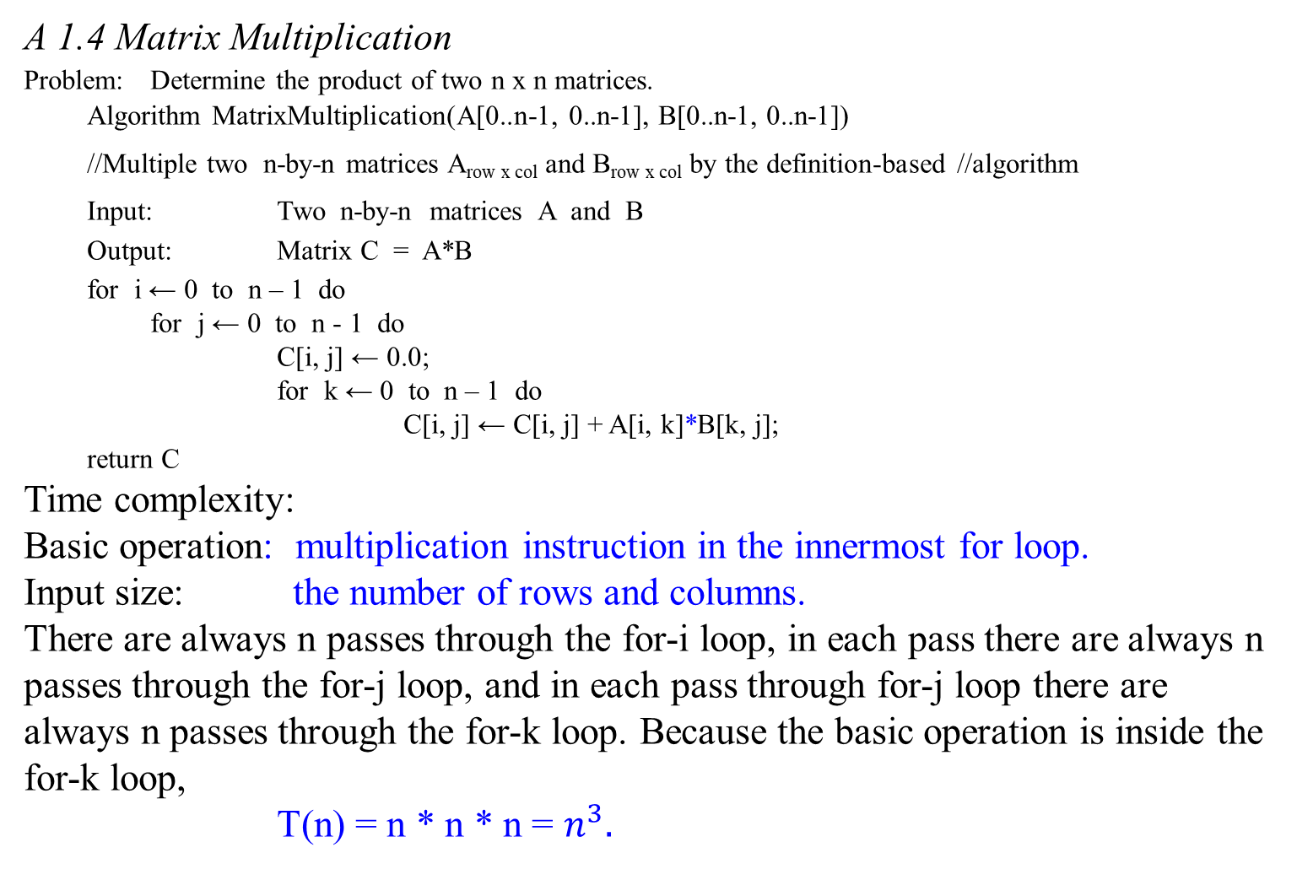
A 1.4 Matrix Multiplication
Problem: Determine the product of two n x n matrices.
Algorithm MatrixMultiplication(A[0..n-1, 0..n-1], B[0..n-1, 0..n-1])
//Multiple two n-by-n matrices A_{row x col} and B_{row x col} by the definition-based //algorithm
Input: Two n-by-n matrices A and B
Output: Matrix C = A*B
for i ← 0 to n – 1 do
for j ← 0 to n - 1 do
C[i, j] ← 0.0;
for k ← 0 to n – 1 do
C[i, j] ← C[i, j] + A[i, k]*B[k, j];
return C
Time complexity:
Basic operation: multiplication instruction in the innermost for loop.
Input size: the number of rows and columns.
There are always n passes through the for-i loop, in each pass there are always n passes through the for-j loop, and in each pass through for-j loop there are always n passes through the for-k loop. Because the basic operation is inside the for-k loop,
T(n) = n * n * n = $n^{3}.$

Slide 25
A 1.5 Binary Search
Problem: Determine whether x is in the sorted array A of n keys.
Inputs: positive integer n, sorted (nondecreasing order) array of keys A
indexed from 0 to n – 1, a key K.
Outputs: location, the location of key in A (0 if K is not in A).
Algorithm BinarySearch(A[0 .. n-1], K)
//Implements nonrecursive binary search
Input: An array A[0 .. n-1] sorted in ascending order and
a search key K
Output: An index of the array’s element that is equal to K
or -1 if there is no such element
…

Slide 26

A 1.5 Binary Search
Algorithm BinarySearch(A[0 .. n-1], K)
//Implements nonrecursive binary search
Input: An array A[0 .. n-1] sorted in ascending order and
a search key K
Output: An index of the array’s element that is equal to K
or -1 if there is no such element
p ← 0; r ← n - 1;
while (p ≤ r) do{
m ← └ (p + r)/2 ┘; // x – 1 < └ x ┘ $≤$x;
if (K = A[m])
then return m;
else if (K < A[m])
then r ← m – 1;
else p ← m + 1; }
return -1;
Q: Which one is the basic operation?

Slide 27
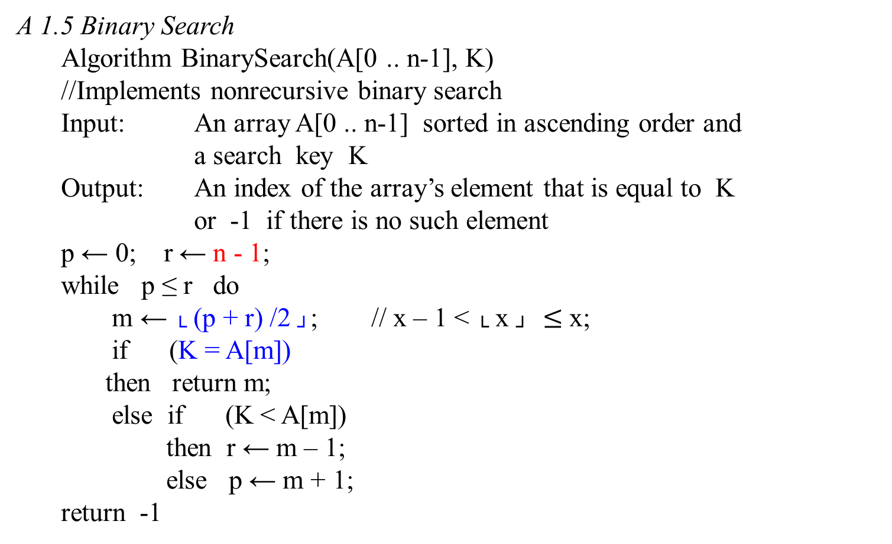
A 1.5 Binary Search
Algorithm BinarySearch(A[0 .. n-1], K)
//Implements nonrecursive binary search
Input: An array A[0 .. n-1] sorted in ascending order and
a search key K
Output: An index of the array’s element that is equal to K
or -1 if there is no such element
p ← 0; r ← n - 1;
while p ≤ r do
m ← └ (p + r) /2 ┘; // x – 1 < └ x ┘ $≤$x;
if (K = A[m])
then return m;
else if (K < A[m])
then r ← m – 1;
else p ← m + 1;
return -1
Q: Which one is the basic operation?
p
m
r

Slide 28

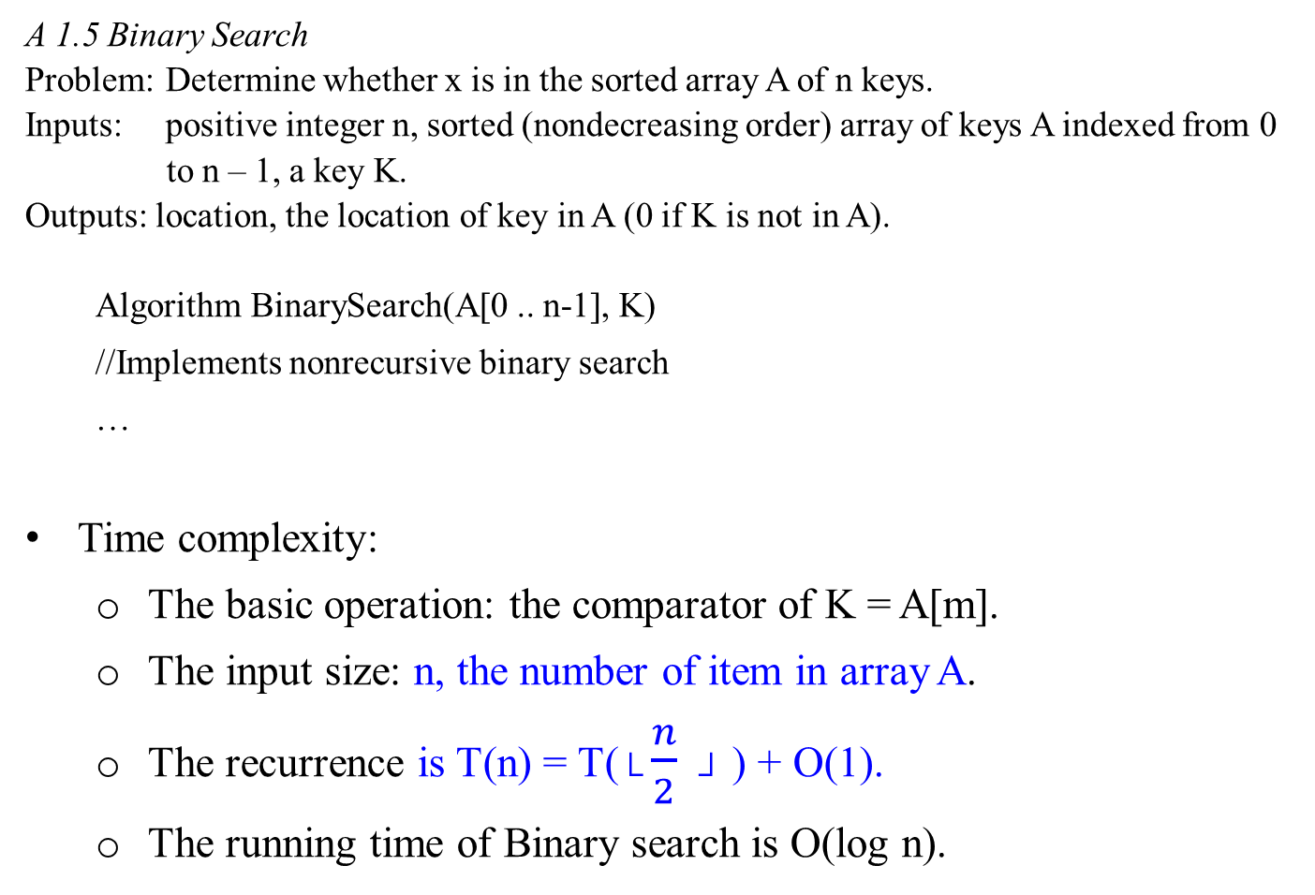
A 1.5 Binary Search
Problem: Determine whether x is in the sorted array A of n keys.
Inputs: positive integer n, sorted (nondecreasing order) array of keys A indexed from 0
to n – 1, a key K.
Outputs: location, the location of key in A (0 if K is not in A).
Algorithm BinarySearch(A[0 .. n-1], K)
//Implements nonrecursive binary search
…
Time complexity:
The basic operation: the comparator of K = A[m].
The input size: n, the number of item in array A.
The recurrence is T(n) = T($└\frac{n}{2} ┘$ ) + O(1).
The running time of Binary search is O(log n).

Slide 29
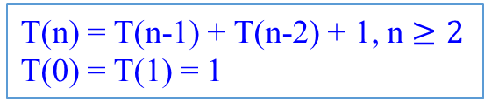
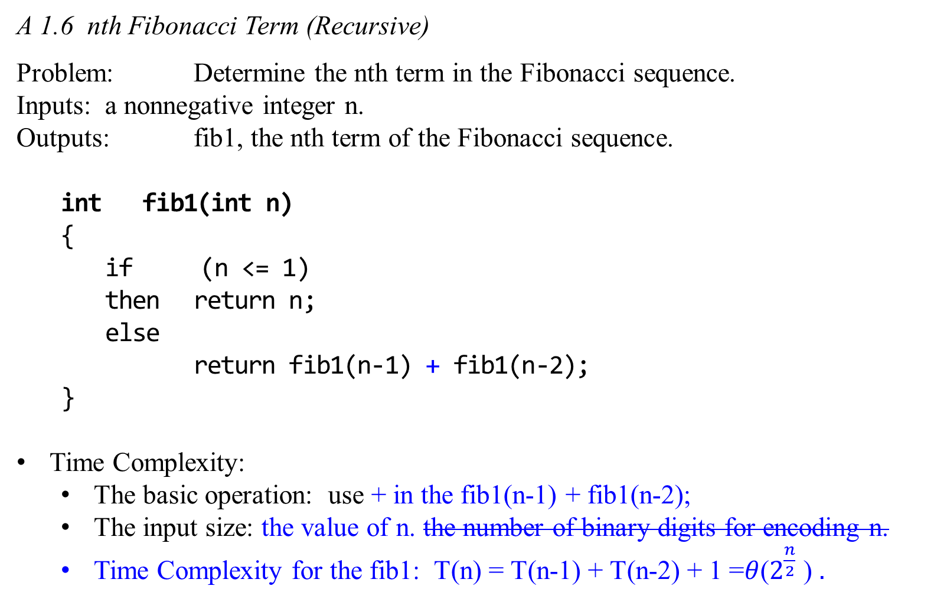
A 1.6 nth Fibonacci Term (Recursive)
Problem: Determine the nth term in the Fibonacci sequence.
Inputs: a nonnegative integer n.
Outputs: fib1, the nth term of the Fibonacci sequence.
int fib1(int n)
{
if (n <= 1)
then return n;
else
return fib1(n-1) + fib1(n-2);
}
Time Complexity:
The basic operation: use + in the fib1(n-1) + fib1(n-2);
The input size: the value of n. the number of binary digits for encoding n.
Time Complexity for the fib1: T(n) = T(n-1) + T(n-2) + 1 =$θ$($2^{\frac{n}{2}}$ ) $.$
Fibonacci numbers:
0 1 1 2 3 5 8 13 …
T(n) = T(n-1) + T(n-2) + 1, n $≥2$
T(0) = T(1) = 1
A serious error!

Slide 30

A 1.7 nth Fibonacci Term (Iterative)
Problem: Determine the nth term in the Fibonacci sequence.
Inputs: a nonnegative integer n.
Outputs: fib2, the nth term of the Fibonacci sequence.
int fib2(int n)
{
index i;
int f[0 .. n];
f[0] = 0;
if (n > 0) {
f[1] = 1;
for (i = 2; i <= n; i++)
f[i] = f[i – 1] + f[i - 2]; //end forLoop
} //end of if
return f[n];
}
The basic operation: the + in the f[i] = f[i – 1] + f[i - 2];
The input size: the value of n.
Time Complexity is linear in n.

Slide 31
A 1.7 nth Fibonacci Term (Iterative)
Problem: Determine the nth term in the Fibonacci sequence.
Inputs: a nonnegative integer n.
Outputs: fib2, the nth term of the Fibonacci sequence.
int fib2(int n);
…
Time complexity:
The basic operation: the + in the f[i] = f[i – 1] + f[i - 2];
The input size: the value of n is the number of binary digits for encoding n.
The number of computer steps used by fib2 is linear in n.
The inner loop consists of a single computer step and is executed n -1 times.
From exponential we are down to polynomial, a high breakthrough in running time.

Slide 32
Compute Fibonacci Numbers

Slide 33
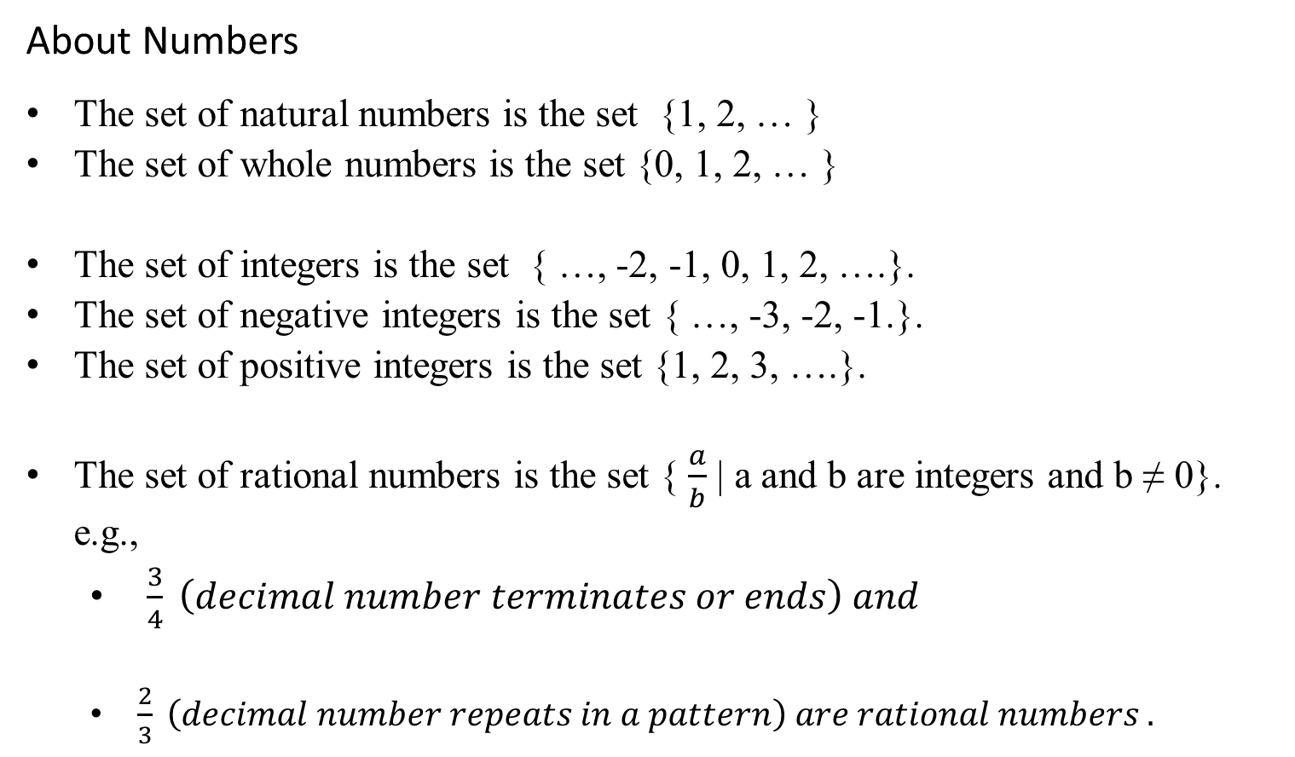
About Numbers
The set of natural numbers is the set {1, 2, … }
The set of whole numbers is the set {0, 1, 2, … }
The set of integers is the set { …, -2, -1, 0, 1, 2, ….}.
The set of negative integers is the set { …, -3, -2, -1.}.
The set of positive integers is the set {1, 2, 3, ….}.
The set of rational numbers is the set { $\frac{a}{b}$ | a and b are integers and b ≠ 0}. e.g.,
$\frac{3}{4} \left(decimal number terminates or ends\right) and$
$\frac{2}{3} \left(decimal number repeats in a pattern\right) are rational numbers .$

Slide 34
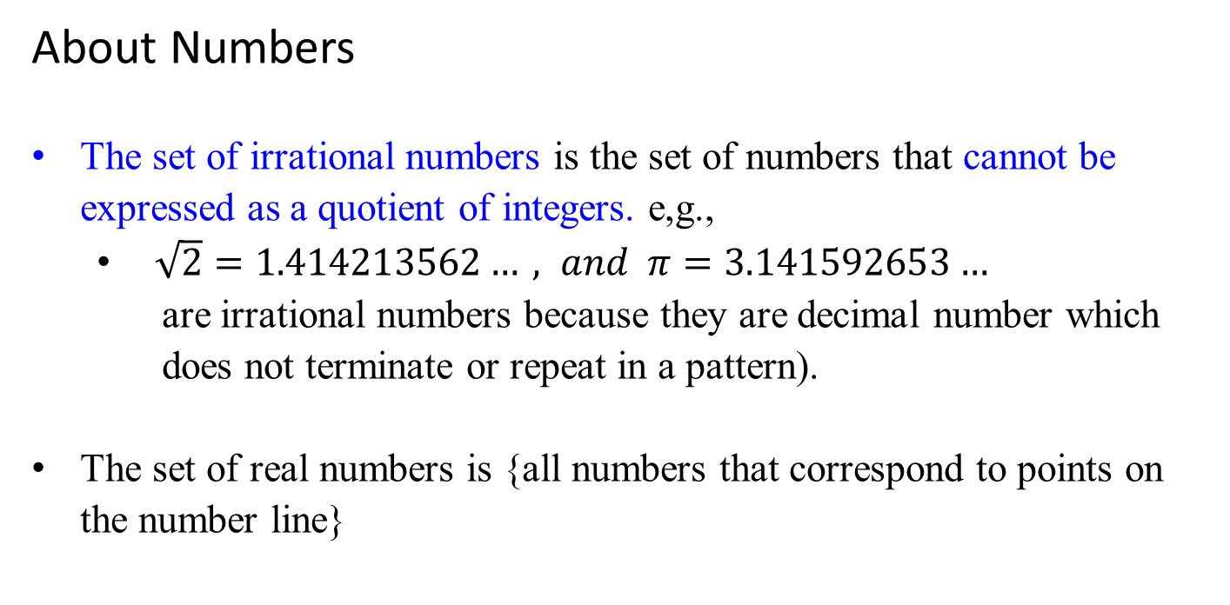
About Numbers
The set of irrational numbers is the set of numbers that cannot be expressed as a quotient of integers. e,g.,
$\sqrt{2}=1.414213562…, and π=3.141592653…$
are irrational numbers because they are decimal number which does not terminate or repeat in a pattern).
The set of real numbers is {all numbers that correspond to points on the number line}

Slide 35
About Numbers
Common Sets of Numbers
Real Numbers (Irrational Numbers, Rational Numbers (Noninteger Rational Numbers, Integers( Negative Integers, Whole Numbers (Zero, Natural Numbers or Positive Integers) ) ) )
Note: Signed numbers are negative numbers and positive numbers.

Slide 36
The Fibonacci Sequence
History
Around AD 600, the decimal system invented the decimal system using only 10 symbols for quantitative reasoning. Large numbers could be written down compactly, and arithmetic could be done efficiently. Al Khwarizmi, who lived in Baghdad, laid out the basic methods for adding, multiplying and dividing numbers, even extracting square roots and calculating digits of π. These procedures were precise, unambiguous, mechanical, efficient, correct – in short, they were algorithms.
This decimal positional system and its numerical algorithms have played an enormous role in Western civilization. They enabled science and technology; they accelerated industry and commerce. And when, much later, the computer was finally designed, it explicitly embodied the positional system in its bits and words and arithmetic unit. Scientists then got busy developing more and more complex algorithms for all kinds of problems and inventing novel applications -- ultimately changing the world.

Slide 37
Al Khwarizmi’s work could not have gained a foothold in the West were it not for the efforts of one man: the 13th century Italian Mathematician Leonardo Fibonacci, who used the positional system to develop his famous sequence of numbers
0, 1, 1, 2, 3, 5, 8, 13, 21, 34, …,
Each is the sum of its two immediate predecessors.
Formally, the Fibonacci numbers F_{n} are generated by the simple rule:
F_{n-1} + F_{n-2} if n > 1
F_{n} = 1 if n = 1
0 if n = 0.
No other sequence of numbers has been studied as extensively, or applied to more fields: biology, demography, art, architecture, music, to name just a few. Fibonacci numbers and the powers of 2 are computer science’s favorite sequence.

Slide 38
The Fibonacci numbers grow almost as fast as the powers of 2:
F₃₀ is over a million, and
F₁₀₀ is already 21 digits long!
In general, F_{n} ≈ 2^{0.694n} .
But what is the precise value of F₁₀₀ or of F₂₀₀ ?
Need an algorithm for computing the nth Fibonacci number.

Slide 39
An exponential algorithm
The algorithm for implementing the recursive definition of F_{n} is:
function fib1(n)
if n = 0 then return 0;
if n = 1 then return 1;
return fib1(n-1) + fib1(n-2);
Whenever we have an algorithm, there are three questions we always ask about it:
Is it correct?
2. How much time does it take, as a function of n?
And can we do better?
int fib1(int n)
{
if (n <= 1)
then return n;
else return fib1(n-1) + fib1(n-2);
}

Slide 40

There are three questions we always ask about an algorithm:
Is it correct?
How much time does it take, as a function of n?
And can we do better?
The first question is moot, as the algorithm is precisely Fibonacci’s definition on F_{n}.
For the second question, the algorithm is extremely inefficient.
For example, use this algorithm to compute fib1(5).
Figure 1.1 gives the recursion tree corresponding to the algorithm int fib1(n) when computing the fifth Fibonacci term.

Slide 41
fib(n) = fib1(n-1) + fib1(n-2);
fib1(5)
As the tree shows, the algorithm int fib1(n) is inefficient because values are computed repeatedly.
For example, fib1(2) is computed three times.
fib1(3)
fib1(4)
fib1(1)
fib1(2)
fib1(2)
fib1(3)
fib1(0)
fib1(1)
fib1(0)
fib1(1)
fib1(1)
fib1(2)
Figure 1.1 The recursion tree corresponding to algorithm when computing fib1(5).
fib1(0)
fib1(1)

Slide 42

How inefficient is this algorithm?
As shown in Figure 1.1, the algorithm fib1(n) for 0 ≤ n ≤ 9 computes the following number of terms
fib(n) = fib1(n-1) + fib1(n-2);
The first six values can be obtained by counting the nodes in the subtree rooted at fib1(n) for 0 ≤ n ≤ 5.
The number of terms for fib1(6) is the sum of the nodes in the trees rooted at fib1(5) and fib1(4) plus the one node at the root.
The number of terms for fib1(7) and fib1(8) are 41, and 67, respectively; and so forth.
It is not simple to use a mathematical expression (or, a formula) to describe these numbers 1, 1, 3, 5, 9, 15, 25, 41, 67, 109, ….
In general, T(n) > T(n-1) + T(n-2) by one.
n | Number of Terms Computed, T
0 | 1
1 | 1
2 | 3
3 | 5
4 | 9
5 | 15
6 | 25
7 | 41
8 | 67
9 | 109

Slide 43


fib(n) = fib1(n-1) + fib1(n-2);
T(9) = T(8) + T(7) > 2*T(7)
T(7) = T(6) + T(5) > 2*T(5)
T(5) = T(4) + T(3) > 2*T(3)
T(3) = T(2) + T(1) > 2*T(1)
Thus,
T(9) = 2*2*2*2*T(1)
Let T(n) be the number of terms in the recursive tree for n.
T(n) > T(n-1) + T(n-2). We have:
T(n) > 2 * T(n - 2), when n ≥ 2
> 2 * 2 * T(n - 4)
> 2 * 2 * 2 * T(n - 6)
...
> 2 * 2 * 2 * … * 2 * T(0) or 2 * 2 * 2 * … * 2 * T(1)
$\frac{n}{2}$ terms $\frac{n}{2}$ terms
depending upon n is even or odd. e.g., T(8) > 2T(6) > 2*2T(4) > 2*2*2T(2) > 2*2*2*2T(0)
T(9) > 2T(7) > 2*2T(5) > 2*2*2T(3) > 2*2*2*2T(1)
Because T(0) = 1 and T(1) = 1, T(n) > $2^{\frac{n}{2}}$.
Use induction to show that this is true for n ≥ 2 even if n is not even.
This inequality does not hold for n = 1 because T(1), which is less than $2^{\frac{1}{2}}$.

Slide 44
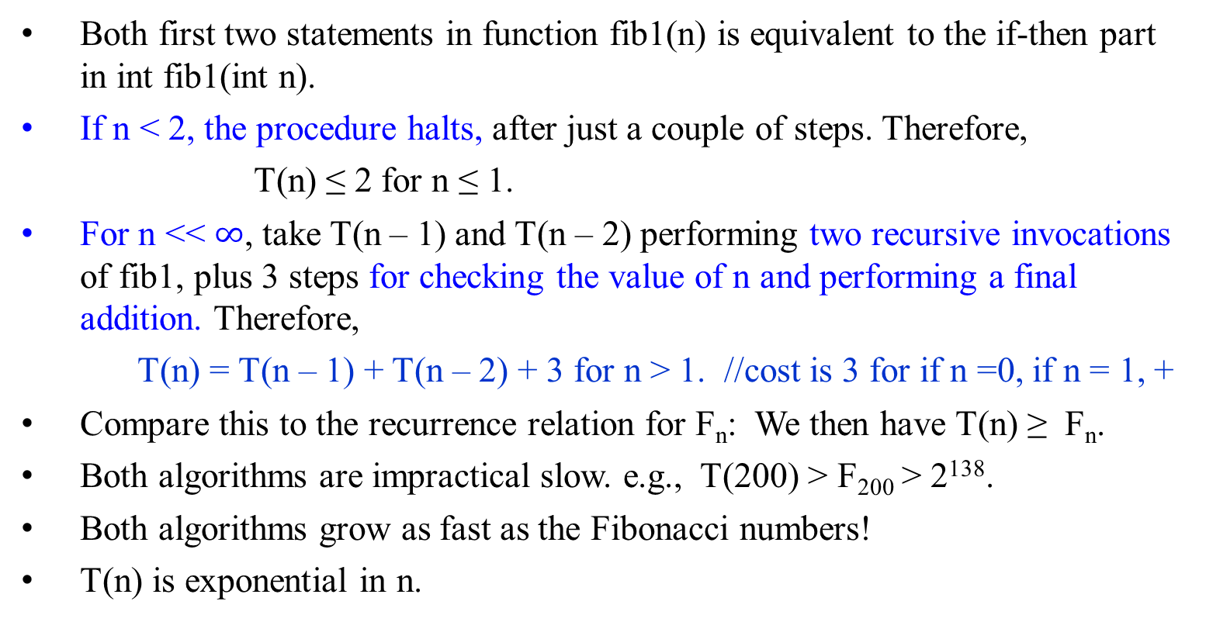
function fib1(n)
if n = 0 then return 0;
if n = 1 then return 1;
return fib1(n-1) + fib1(n-2);
int fib1(int n) {
if (n <= 1)
then return n;
else return fib1(n-1) + fib1(n-2); }
Both first two statements in function fib1(n) is equivalent to the if-then part in int fib1(int n).
If n < 2, the procedure halts, after just a couple of steps. Therefore,
T(n) ≤ 2 for n ≤ 1.
For n << $∞$, take T(n – 1) and T(n – 2) performing two recursive invocations of fib1, plus 3 steps for checking the value of n and performing a final addition. Therefore,
T(n) = T(n – 1) + T(n – 2) + 3 for n > 1. //cost is 3 for if n =0, if n = 1, +
Compare this to the recurrence relation for F_{n}: We then have T(n) ≥ F_{n}.
Both algorithms are impractical slow. e.g., T(200) > F₂₀₀ > 2¹³⁸.
Both algorithms grow as fast as the Fibonacci numbers!
T(n) is exponential in n.

Slide 45

Theorem 1.1
If T(n) is the number of terms in the recursion tree corresponding to algorithm fib1(n), then for n ≥ 2,
T(n) > $2^{\frac{n}{2}}$.
Proof. The proof is by induction on n.
Induction base:
The induction step assumes the results of two previous cases. We need two base cases: For n = 2 and n = 3, the recursion in Figure 1.1 shows that
T(2) = 3 > 2 * T(0) = 2 * 1 = 2 = $2^{\frac{2}{2}}$.
T(3) = 5 > 2 * T(1) = 2 * 1 = 2 $≈$ $2^{\frac{3}{2}} ≈$2.8323.

Slide 46

Continue proof of Theorem 1.1:
Induction hypothesis:
Assume that T(m) > $2^{\frac{m}{2}}$ is true for all m < n. Then, in the induction step, we have to show that this implies that T(n) > $2^{\frac{n}{2}}$ must be true for n. Suppose for all m such that 2 ≤ m < n, T(m) > $2^{\frac{m}{2}}$ is true. We need to show that T(n) > $2^{\frac{n}{2}}$ is also true.
Since the value of T(n) = T(n - 1) + T(n - 2) plus the one node at the root. Therefore,
T(n) = T(n - 1) + T(n - 2) +1
> $2^{\frac{n−1}{2}}$ + $2^{\frac{n−2}{2}}$ + 1 (by induction hypothesis)
> $2^{\frac{n−2}{2}}$ + $2^{\frac{n−2}{2}}$
= 2 * $2^{\frac{n}{2}−1}$
= $2^{\frac{n}{2}}$. QED

Slide 47

Analysis of the Algorithm: function fib1(n)
fib1(n) computes the nth Fibonacci term.
The number of terms computed by fib1(n) is greater than $2^{\frac{n}{2}}$.
The running time of fib1(n) grows as fast as the Fibonacci numbers!
T(n) > $2^{\frac{n}{2}}$;
T(n) is exponential in n; and is extremely inefficient.
fib1(n) is impractical slow except for very small value of n.
…

Slide 48


Let’s be a little more concrete about just how bad exponential time is.
To compute F₂₀₀, the fib1 executes T(200) ≥ F₂₀₀ ≥ $2^{138}$ elementary computer steps.
If we use the NEC Earth Simulator, one of the fastest computer in the world, which clocks 40 trillion steps per second, it would take $2^{92}$ seconds to compute fib1(200).
This means that, if we start the computation today, it would still be going long after the sun turns into a red giant star.
…

Slide 49

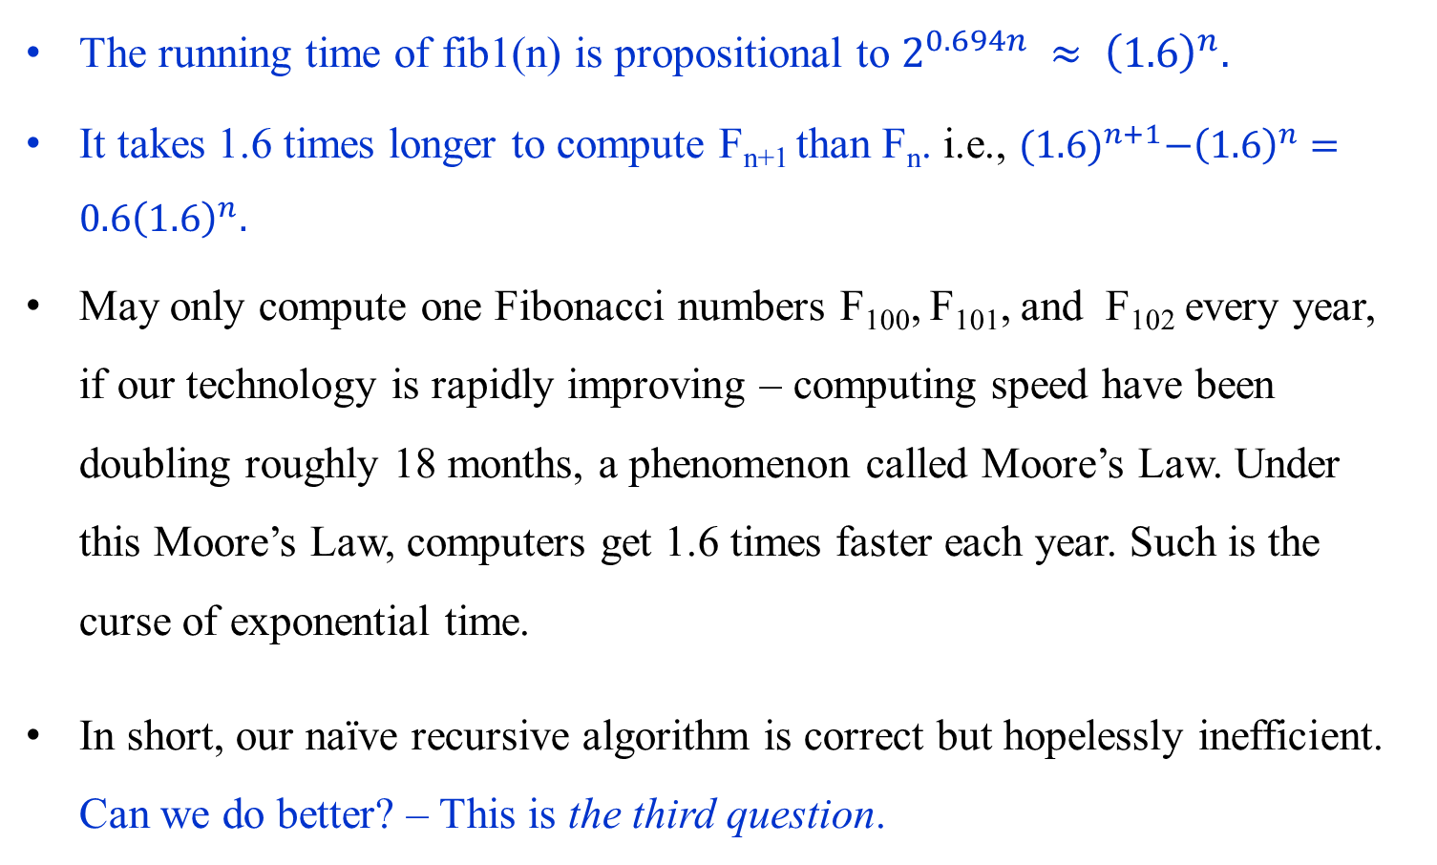
The running time of fib1(n) is propositional to $2^{0.694n} ≈ {\left(1.6\right)}^{n}.$
It takes 1.6 times longer to compute F_{n+1} than F_{n}. i.e., ${(1.6)}^{n+1}−{\left(1.6\right)}^{n}=0.6{\left(1.6\right)}^{n}.$
May only compute one Fibonacci numbers F₁₀₀, F₁₀₁, and F₁₀₂ every year, if our technology is rapidly improving – computing speed have been doubling roughly 18 months, a phenomenon called Moore’s Law. Under this Moore’s Law, computers get 1.6 times faster each year. Such is the curse of exponential time.
In short, our naïve recursive algorithm is correct but hopelessly inefficient. Can we do better? – This is the third question.

Slide 50
Can we do better?
A Polynomial Algorithm
Why is fib1 so slow?
Figure 1.1 shows the cascade of recursive invocations triggered by a single call to fib1(n).
The same value are computed repeatedly!
Figure 1.1 shows that in determining fib1(5), fib1(2) is computed three times and fib(3) is computed two times.
A sensible solution:
Store the intermediate results – the computed values F₀, F₁, F₂, …, F_{n-1} in an array, for avoiding recompute them.
The following iterative algorithm uses this strategy.

Slide 51



As with fib1, the correctness of this algorithm fib2(n) is self-evident because it directly uses the definition of F_{n}.
How long does it take?
The + in the body of the for-loop is executed n -1 times. Or (i $≤$ n) is executed n times.
The number of computed steps used by fib2 is linear in n, $θ(n)$.
The running time is down from exponential to polynomial $θ(n2)$, a huge breakthrough in running time. (Addition requires $θ(n)$.)
It is perfectly reasonable to computer F₂₀₀ or even F_{200,200}.
function fib2(n)
if (n == 0) then return 0;
create an array f[0 .. n];
f[0] = 0; f[1] = 1;
for (i = 2; i $≤$ n; i++){
f[i] = f[i – 1] + f[i + 2];}
return f[n];

Slide 52

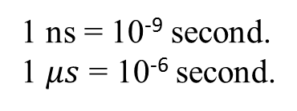
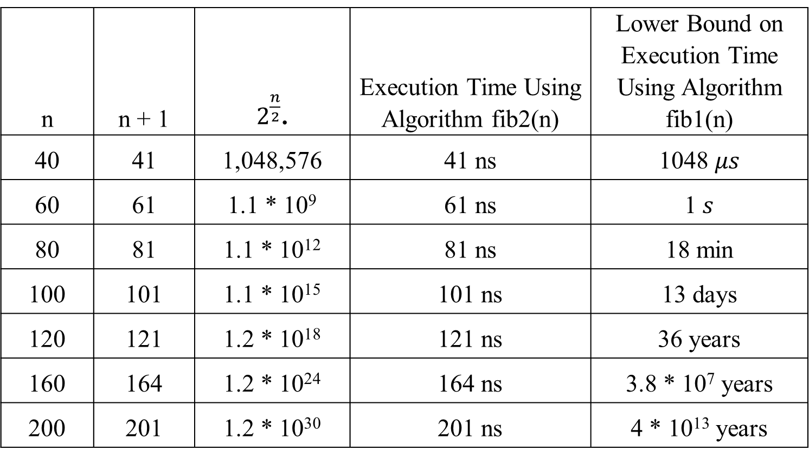
n | n + 1 | $2^{\frac{n}{2}}$. | Execution Time Using Algorithm fib2(n) | Lower Bound on Execution Time Using Algorithm fib1(n)
40 | 41 | 1,048,576 | 41 ns | 1048 $μs$
60 | 61 | 1.1 * 10⁹ | 61 ns | 1$s$
80 | 81 | 1.1 * 10¹² | 81 ns | 18 min
100 | 101 | 1.1 * 10¹⁵ | 101 ns | 13 days
120 | 121 | 1.2 * 10¹⁸ | 121 ns | 36 years
160 | 164 | 1.2 * 10²⁴ | 164 ns | 3.8 * 10⁷ years
200 | 201 | 1.2 * 10³⁰ | 201 ns | 4 * 10¹³ years
1 ns = 10⁻⁹ second.
1 $μs$ = 10⁻⁶ second.
Table 1.1 A comparison of Algorithms fib1(n) and fib2(n)

Slide 53

Later, we will see
function fib1(n) is a divide-and-conquer algorithm.
The divide-and-conquer strategy produces
efficient algorithms for problems, (such as Binary Search for searching a sorted array).
inefficient algorithms for other problems (such as fib1(n)).
fib1(n) computes at least an exponentially large number of terms, $2^{0.694n} ≈ {(1.6)}^{n}$;
could it be even worse? The answer is no.
fib2(n) is an example of the dynamic programming strategy, $θ(n2)$.
an efficient algorithm for computing the nth Fibonacci term.

Slide 54
To be continued

